Slide 1
Image Caption Generator
ECE 5831 Final Project
Sankalp Rajeev

Slide 2
Introduction
What is Image Captioning?
Generating textual descriptions for given images using AI.
Why is it Important?
Assistive technologies (e.g., visually impaired users).
Automated content annotation.
Smart surveillance systems.

Slide 3
Project Workflow
Data Cleaning: Resize images, tokenize, and clean captions.
Feature Extraction: Using InceptionV3 for image features.
Caption Generation: LSTM processes image features and partial captions.
Training: Flickr8k dataset with GloVe embeddings.
Inference: Beam search to generate optimized captions.
Deployment: Flask-based web app for real-time captioning.

Slide 4
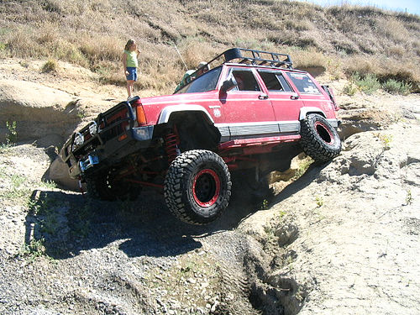
Dataset: Flickr8k
Size:
8,000 Images
40,000 Captions (5 captions per image)
Format: Images (JPG) + Captions (Text)
Sample Data:
Image: Shown on right
Captions:
“A four wheel drive car is navigating along a rocky off road trail”
Why Flickr8k?
Compact yet diverse dataset for prototyping.
Sufficient captions for learning image-text relationships.
Computationally efficient for training with limited resources.

Slide 5
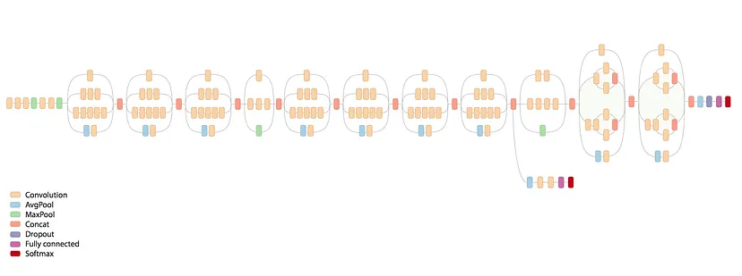
InceptionV3: Image Feature Extraction
Purpose: Extract high-dimensional image features.
Architecture:
A pre-trained Convolutional Neural Network (CNN) trained on ImageNet (1.2M images).
Produces a 2048-dimensional vector as an image feature.
Why InceptionV3?:
High accuracy for image classification tasks.
Efficient with reduced computational cost (factorized convolutions).
Allows transfer learning, saving training time.

Slide 6
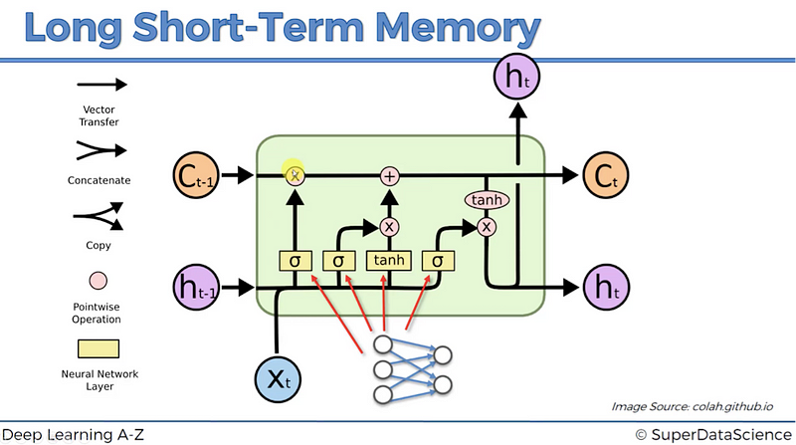
LSTM: Caption Generation
Purpose: Generate sequential text (captions) from image features.
Key Properties:
Handles long-term dependencies in text sequences.
Prevents vanishing gradient issues (uses gates: input, forget, and output).
How It Works:
Input: Image features + tokenized captions.
Output: Predicts the next word in the caption iteratively.
Why LSTM?:
Well-suited for text generation tasks.
Captures contextual relationships between words.

Slide 7
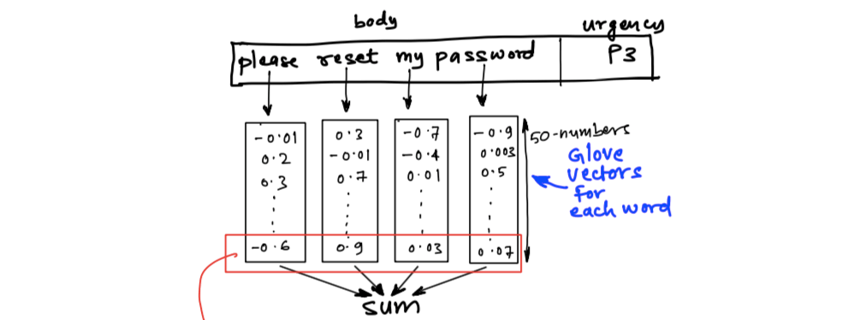
GloVe Embeddings
What are GloVe Embeddings?
GloVe stands for Global Vectors for Word Representation.
Pre-trained word embeddings that map words to dense vector representations based on word co-occurrence in large text corpora.
Why Use GloVe?
Captures semantic relationships (e.g., “king” - “man” + “woman” = “queen”).
Improves model understanding of word context and meaning.
Reduces the need for training word embeddings from scratch.
Integration in Model:
The Embedding layer uses GloVe to convert tokenized words into 200-dimensional vectors.
This layer is non-trainable to preserve pre-trained semantic knowledge.

Slide 8
Beam Search Optimization
What is Beam Search?
Beam Search is an optimization technique used to improve sequence generation.
Instead of choosing the most probable word at each step (greedy search), it explores multiple candidate sequences.
How it Works:
At each time step, the model predicts the top k most likely words (where k is the beam width).
These k words are expanded into sequences, and the top k sequences are retained based on cumulative probabilities.
This process continues until the end-of-sequence token is generated.
Why Use Beam Search?
It produces more coherent and diverse captions by exploring multiple paths.
Balances accuracy and computational efficiency by limiting the beam width.
Example (Beam Width = 3):
Partial Caption: "A dog is…"
Top Candidates:
"playing" (0.8)
"running" (0.7)
"sitting" (0.6)
These candidates are expanded to form the next set of top sequences.

Slide 9
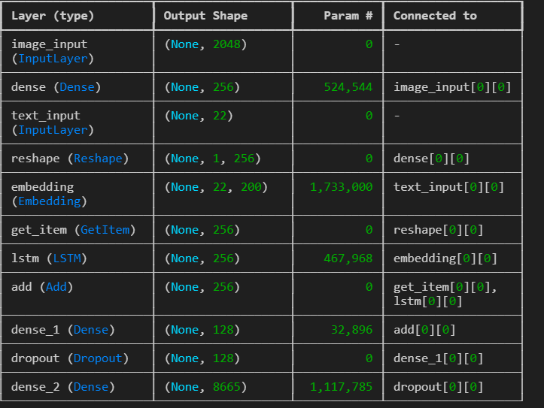
Model Layers
Input layers for images and captions.
Dense layers for reducing dimensionality.
Reshape and Embedding layers for alignment.
LSTM layer for sequence prediction.
Dense and Dropout layers for final word prediction.

Slide 10
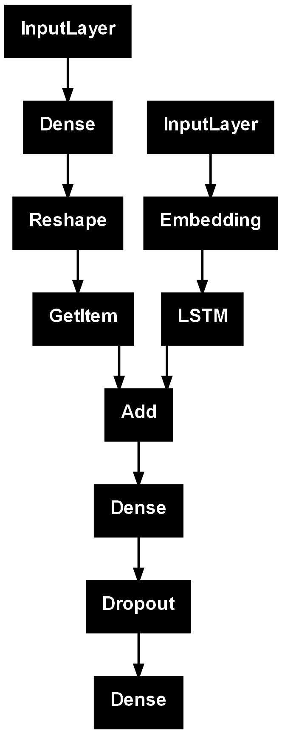
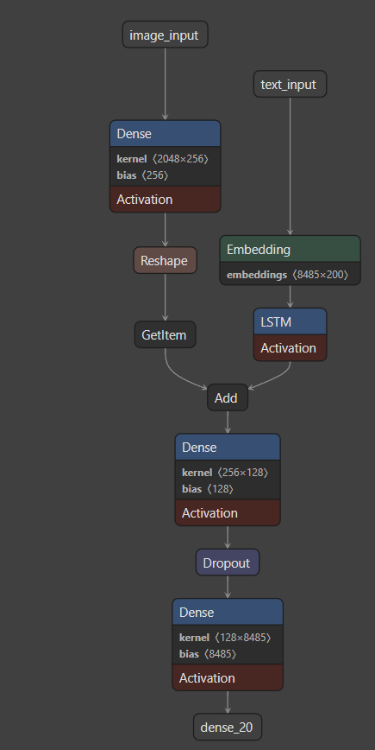
Model Architecture
Encoder: InceptionV3 (extracts 2048-dimensional image features).
Decoder: LSTM processes image and text embeddings.
Integration: GloVe word embeddings, dense layers, and dropout.

Slide 11
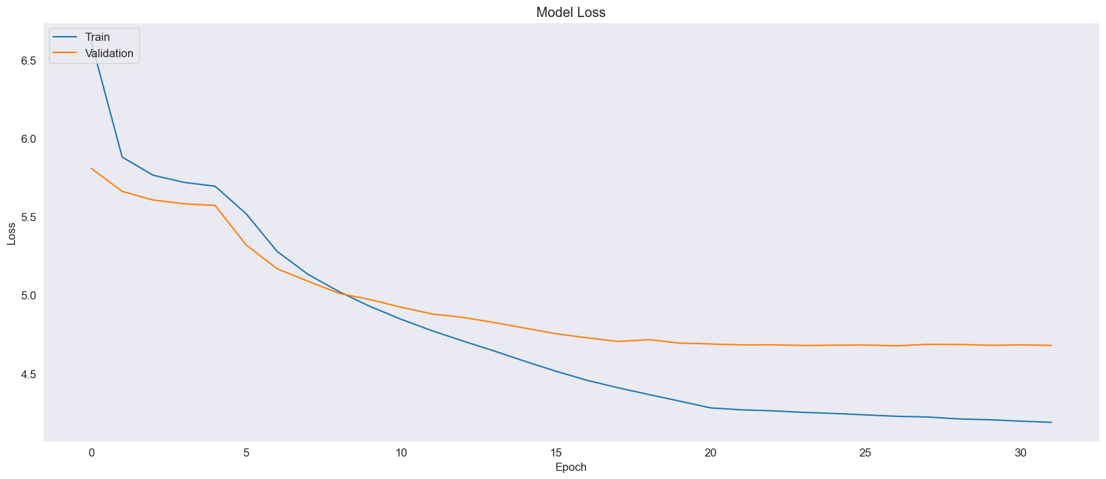
Training and Validation Loss
Training Loss consistently decreases over epochs.
Validation Loss stabilizes after ~20 epochs.
Minimal overfitting is observed as the gap between training and validation losses remains narrow.

Slide 12
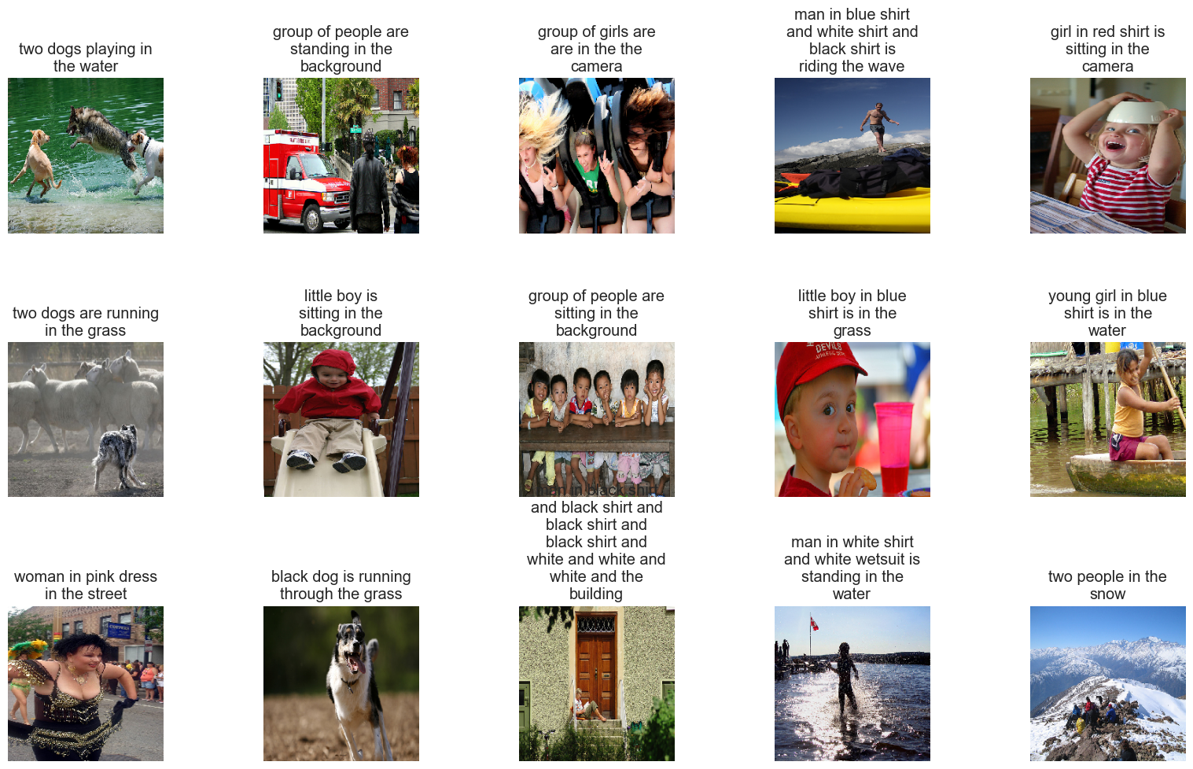
Model Results

Slide 13
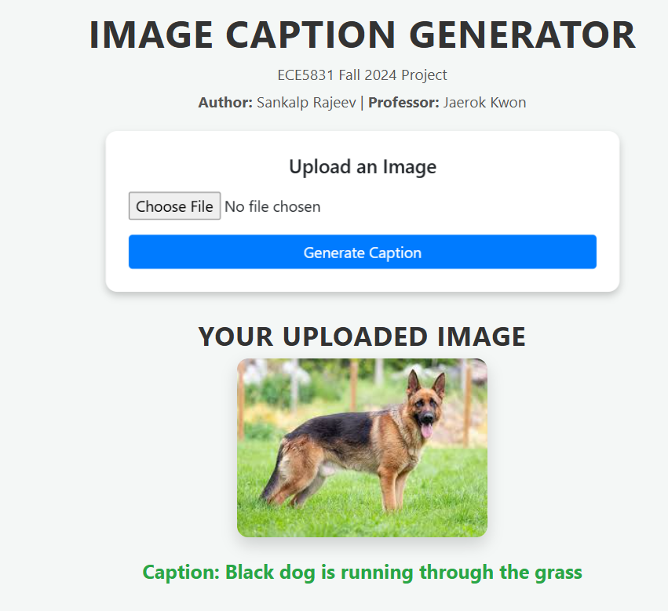
Flask Application
Flask provides a web-based interface.
User Workflow:
Upload an image.
Model processes the image.
Caption is generated and displayed.

Slide 14
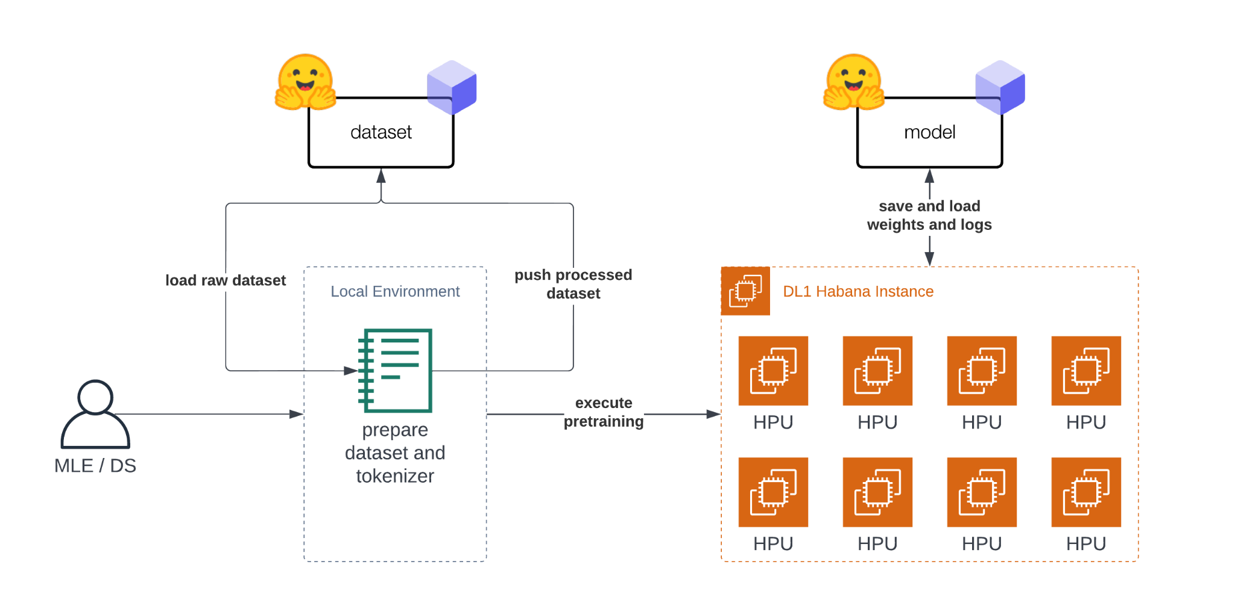
Future Work
Memory Mechanisms:
Transformers (BERT, GPT) for improved contextual accuracy.
Video Captioning:
Extend the system to generate sequential captions for videos.
Data Augmentation: Improve performance with larger, diverse datasets.

Slide 15
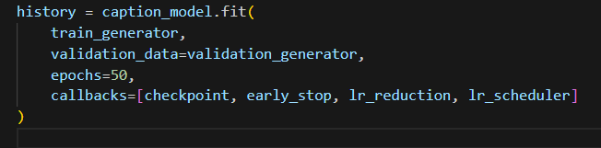
What I Learned from This Project?
Deep Learning Integration: Combining InceptionV3 and LSTM for image captioning.
Optimization Techniques: Learned Beam Search for better caption quality.
Real-World Data Handling: Preprocessing and cleaning image-text datasets (Flickr8k).
Model Deployment: Building a real-time Flask web app for accessibility.
Problem-Solving: Debugging and analyzing model performance.
AI Applications: Practical use cases like assistive technology and automation.

Slide 16
Conclusion
Project Summary:
Built an Image Caption Generator combining InceptionV3 for image feature extraction and LSTM for sequential text generation.
Integrated Beam Search for optimized caption generation.
Deployed the model using a Flask-based web application.
Key Achievements:
Efficiency: Real-time caption generation under ~2 seconds per image.
Deployment: A user-friendly interface for image uploads and caption results.

Slide 17
Conclusion - Continued
Applications:
Assistive technology for the visually impaired.
Content-based image retrieval.
Smart surveillance and robotics.
Future Work:
Use Transformers (BERT/GPT) for improved accuracy.
Extend the system to video captioning.
Perform data augmentation and scale to larger datasets.

Slide 18

Thank You

